Slide 1
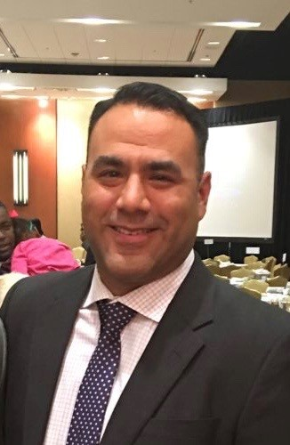
Welcome
Coach Guzman
English III
Conference Period: 8:26-9:15
Email: Richard.Guzman@fortbendisd.com
Phone: 281 634- 7000

Slide 2
Class Rules
Be on Time
Be Respectful
Be Responsible
No Food or Drinks

Slide 3
Cell Phones
All cell phones shall be put away when class starts.
If cell phone is a distraction during class, there will be 2 warnings, after the 2nd warning cell phone will be placed on my desk till the end of class.
Charging station is also available.

Slide 4
Late WOrk
NEW English Department Late Policy:
This year the entire English department has adopted the same Late Policy. It is:
- 15 points off per day.
- As of Day 4 it is worth 0 (ZERO) points.

Slide 5
What if I’m Absent?
You have the same number of Days that you were out to get the assignment in before it counts as late.
If this is at the beginning of a project, this does not count for the entire project; Just the next deadline in the project.

Slide 6
What if I fail an assignment?
Retests are available for any student who fails a test.
You will need to do a “Reteach” opportunity (Come to Tutorials).
The highest grade on a retest is 75%.
If I can’t READ it, I can’t GRADE it.

Slide 7
Plagiarism Policy
1st Offense:
Parent will be contacted and the student will repeat the assignment for a grade of not more than a 50.
2nd Offense:
Repeat parent contact, student will receive a discipline referral to their AP and they will receive a ZERO for the assignment.

Slide 8
How to Get Help
Tutorials:
Tuesday from 7:00-7:30am.
Thursdays from 7:00-7:30am.
Email:
Richard.Guzman@fortbendisd.com

Slide 9
Restroom
10/10 rule- No students should leave the room in the first 10 minutes, or the last 10 minutes of class unless it is an emergency.
NO PASS PERIOD TIMES:
no pass period during Tiger Time
4th and 5th Period

